Slide 1





All-in-Cloud:challenges and future expectations of AiC
Professional Research English 2019
Chenghao Li
Born 2000 in Hunan, China
Second year college student, Harbin Institute of Technology, Shenzhen
School of computer science
Yanqi Pan
Born 2000 in Chongqing, China
Second year college student, Harbin Institute of Technology, Shenzhen
School of computer science
Yunqing He
Born 2000 in Yunnan, China
Second year college student, Harbin Institute of Technology, Shenzhen
School of computer science
Group4

Slide 2
AiC(All-in-Cloud)
It means all the data is stored, processed, transmitted in the cloud, which is totally different from localized data.
Cloud data
localized data

Slide 3
Structure
Future expectations
Why do we need to talk about AiC?
What is the future expectations of AiC?
Challenges
Why do we need to talk about the challenges of AiC?
What are the challenges of AiC?
Conclusion

Slide 4
Future expectations of AiC

Slide 5
Why do we need to talk about AiC?
Trend:
The AiC is becoming a trend of the way the data works
Source: BI Intelligence estimates, 2016
Source: IDC 2019

Slide 6
Why do we need to talk about AiC?
Some companies have put all the data in the cloud already because AiC makes it possible for further demand for data in a way that is more efficient, more powerful and cheaper.
Examples
AWS
Netflix
Alibaba Cloud
115 Tech
Yintai Holdings

Slide 7
What is the future expectations of AiC?
The AiC structure is the extension of the edge network. In this section, we show the overview and basic structure of AiC, which helps form the understanding of AiC.
Development of the cloud
Cloud period
Edge period
All-in-Cloud(AiC) period

Slide 8

Cloud period
Future expectations of AiC
Usually, cloud computing is based on huge number of machines built together with powerful performance to provide data service to users.
Cloud Server

Slide 9
Cloud period
Future expectations of AiC
Big data center
Powerful and flexible
Secure and systematic management system
Far from end devices, end users and some sensors
Latency/Jitter/Packet Loss: high
Centralization

Slide 10
Edge period
Future expectations of AiC
Cloud period
Edge
Server
Close
Edge
Server
Edge
Server
Far
Cloud Server
Edge
Server

Slide 11
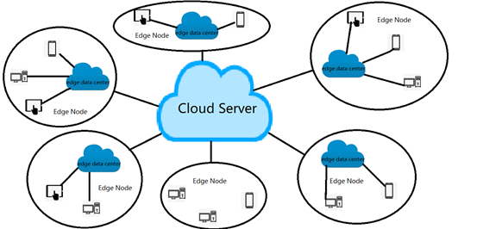
Edge period
Future expectations of AiC
Edge Computing is a complementation and extension of Cloud Computing.
The edge node is smaller cloud devices covering much wider area compared to cloud period.

Slide 12
Future expectations of AiC
Edge period
Edge node: smaller cloud data center
Decentralized in macro view
Centralized in micro view
Not so powerful
Proximity to end devices, end users and some sensors
Latency/Jitter/Packet Loss: low
More devices between end users to the cloud server

Slide 13
Future expectations of AiC
AiC period
All-in-Cloud period can be regarded as the final extension of the cloud period and edge period
AiC should be composed of countless computation devices, storage-rich nodes to be able to carry numerous things.

Slide 14
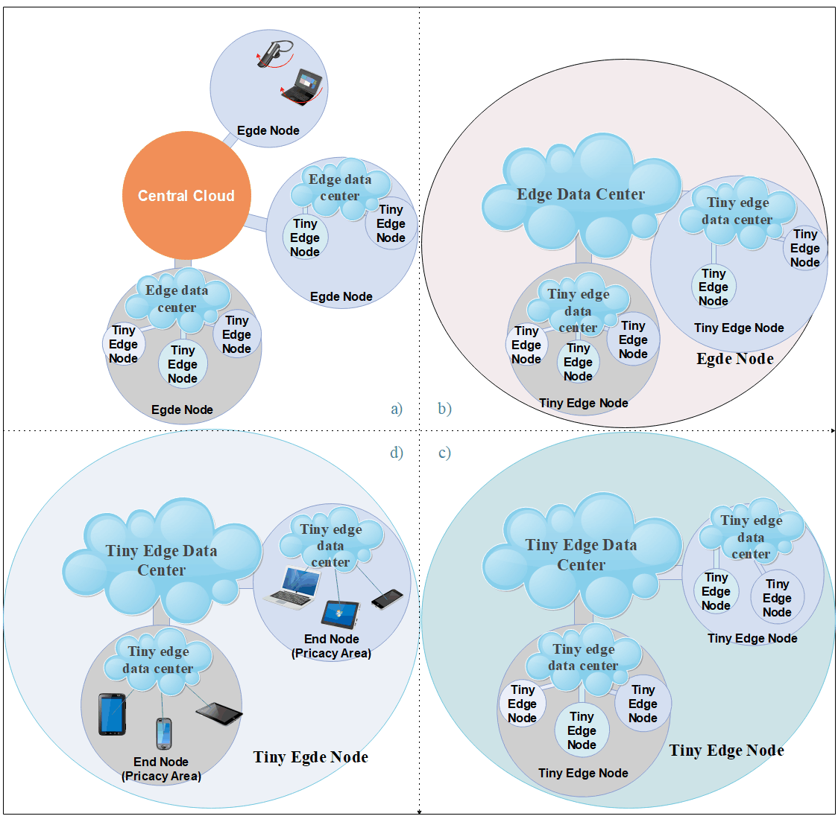
Future expectations of AiC
AiC period
Thousands of edge nodes between end devices and central cloud.
The end devices become much smaller, the number of them are much more than before.

Slide 15
Future expectations of AiC
Cloud period
Edge period
AiC period
Cloud Server
Devices that provide cloud service

Slide 16
Future expectations of AiC
An extension with separate and tiny data centers.
The net of cloud devices become complex.
The change of quantity will cause the change of quality.
Why do we need to talk about the challenges of AiC?
As the structure of the cloud changes, new challenges come.
Focusing on the challenges helps researchers find direction in future area of the cloud.

Slide 17
Challenges of AiC

Slide 18
Challenges of AiC
Data
Transmission
Data
Storage
Data Processing

Slide 19
Data transmission

Slide 20
Challenges of AiC
Data Transmission
Cloud computing, edge computing and AiC all have common network attacks due to connection with the network.
Common network Attacks
Man-in-the-Middle Attack
Denial of network Attack
…

Slide 21

Challenges of AiC
Data Transmission
Due to strong connection of nodes and thousands of edge nodes in the middle of the cloud system, AiC has its unique problems called “Chain Reaction”.

Slide 22
Chain Reaction
Challenges of AiC
Node 1
Node 2
Node 3

Slide 23
Chain Reaction
Challenges of AiC
Node 1
Node 4
Node 2
Node 5
Node 6
Node 3
Node 7

Slide 24
Chain Reaction
Challenges of AiC

Slide 25
Protocol of Standardization
Challenges of AiC
Protocols
Company A
Company B
Company C
Company D

Slide 26
Data Storage

Slide 27
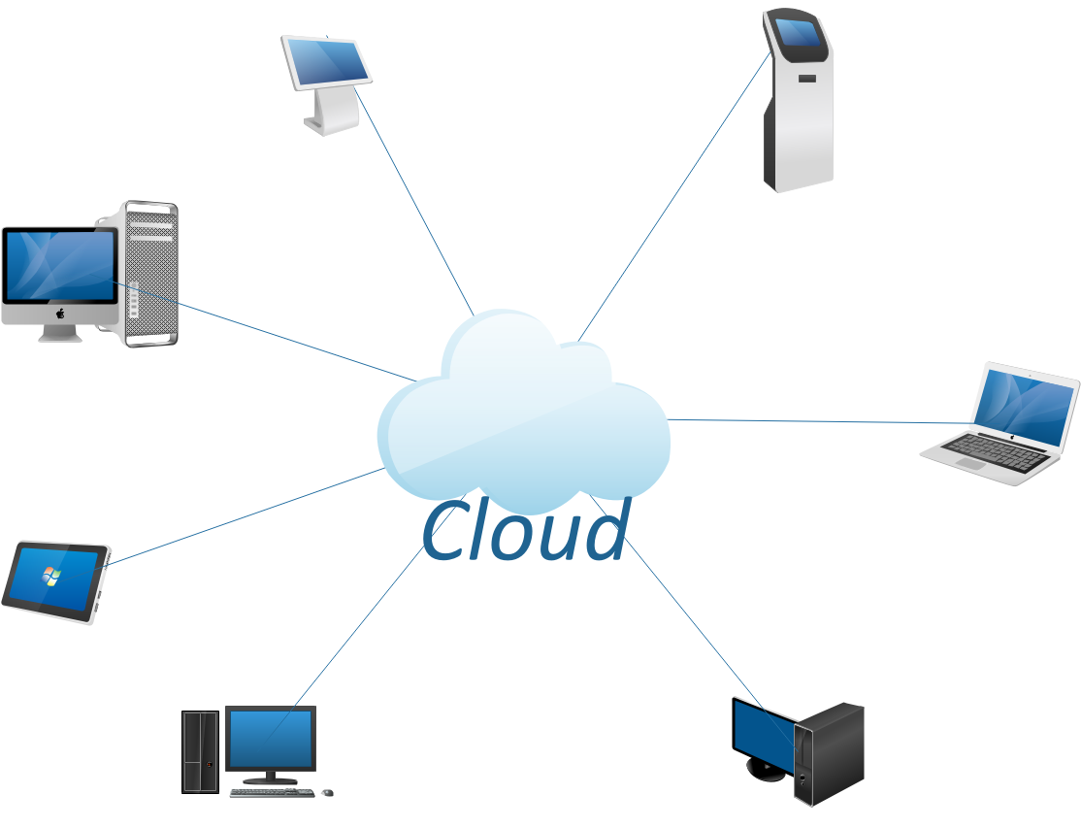
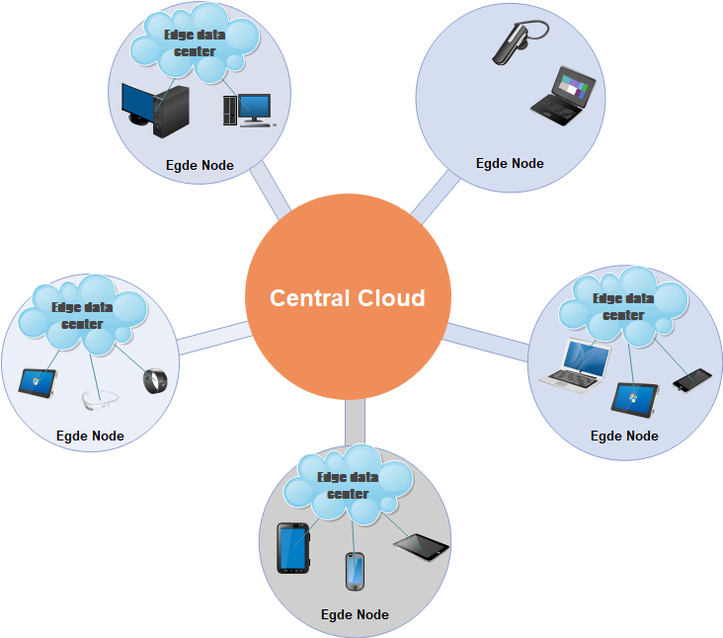
Data Storage
Challenges of AiC
High
Privacy
Leakage
Normal
Seldom
Normal
Physical
Damage
Normal

Slide 28


Data Storage
Challenges of AiC
Data Exposure
Thousand nodes
Decentralized structure
It’s easy to get information from a single device from Linda, who also has thousands of similar devices to take care of. This causes data exposure.
Exposure

Slide 29
Data Processing

Slide 30
Data Processing
Challenges of AiC
Privileges Scalation
User gain illegal rights to disturb the service
Abusing of Privileges Scalation
Manager abuses of his rights to disturb the Service
AiC shares almost the same challenges in data processing.

Slide 31
Conclusion

Slide 32
Conclusion
The AiC structure is the extension of the edge computing and cloud computing.
The change of quantity will cause the change of quality.
Focusing on new challenges helps researchers find direction in future area of the cloud.

Slide 33
All-in-Cloud:challenges and future expectations of AiC
Professional Research English 2019
Chenghao Li
Yanqi Pan
Yunqing He
Group4

